Slide 1
Final Presentation
Natural Language Processing
Rebecka Fahrni , Joseph Weibel

Slide 2
Agenda
Recap Project Goal
Dataset Overview
Baseline model
Applying BERT-like and GPT-like models

Slide 3

Recap Project’s Goal
Classification of medical transcriptions into medical specialties

Slide 4
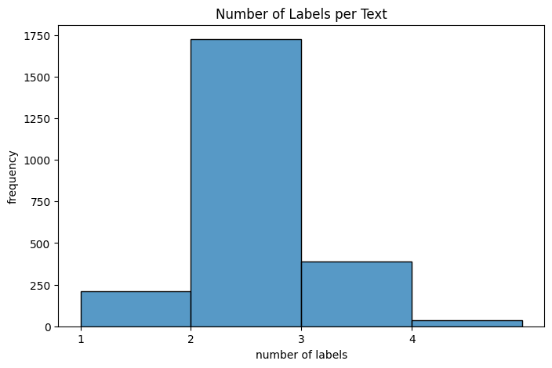
Dataset Overview
Multi-Label
Medical transcriptions for various medical specialties

Slide 5

Evaluation Strategy
Evaluation of Methods by 3-fold cross-validation to ensure robust model assessment

Slide 6
Baseline Models
Pipeline:
TF-IDF with Naive Bayes / SVM
Pre-processing:
standarize text length (512tokens)
Lowercasing
Stemming (Snowball) / Lemmatization
Punctuations, numbers removal
Label preprocessing: filtering out labels with fewer than 20 texts to focus on more significant labels
Oversampling

Slide 7
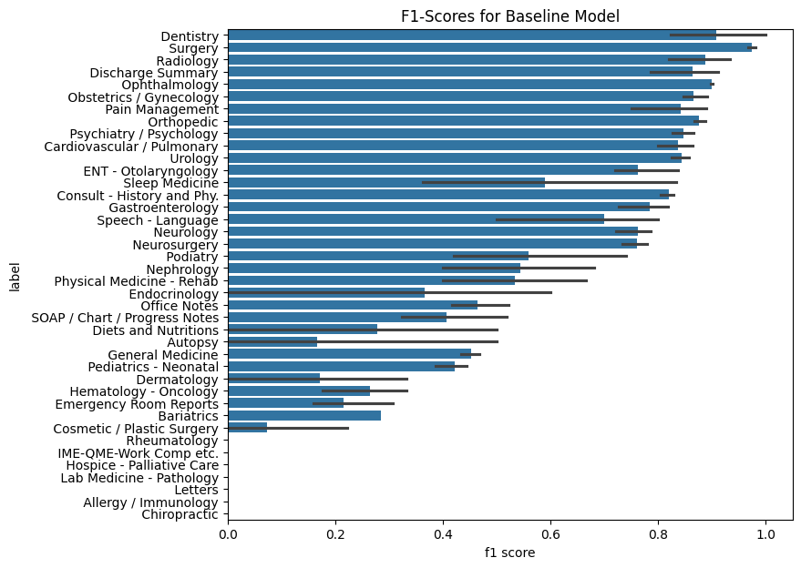
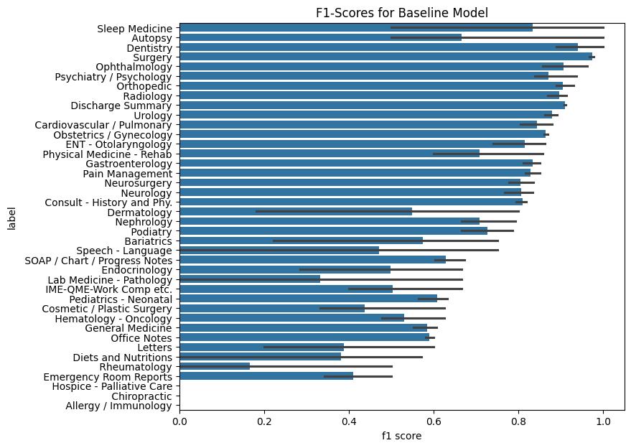
F1-Scores for Baseline Model - sVM
SVM – unbalanced class weights
SVM – balanced class weights

Slide 8
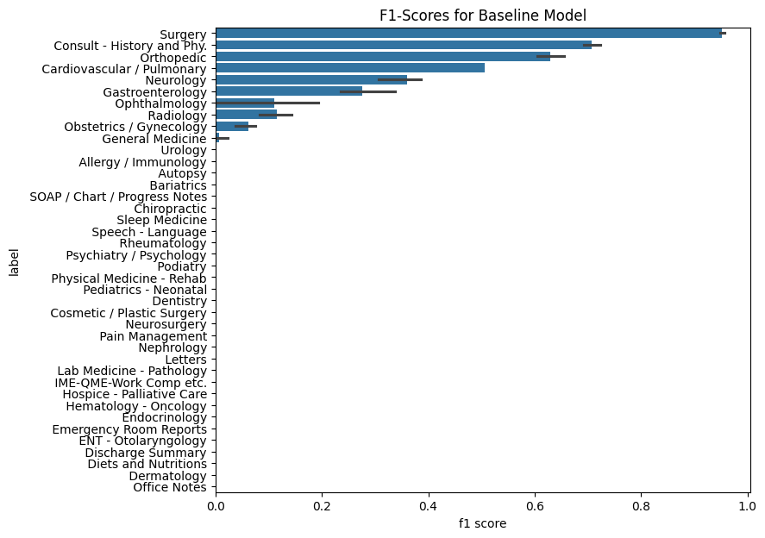
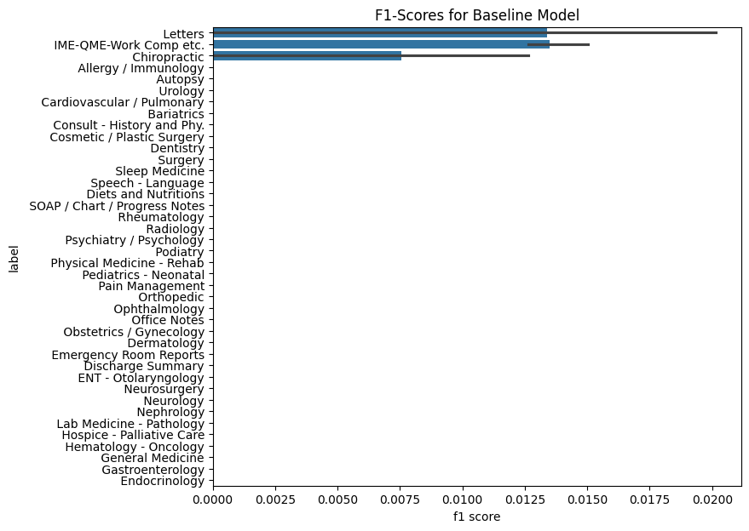
F1-Scores for Baseline Model - Naive Bayes
NB - unbalanced class weights
NB - balanced class weights
Other models can handle imbalanced data better. Random Forests or Gradient Boosting Machines can be more resilient to class imbalance.

Slide 9
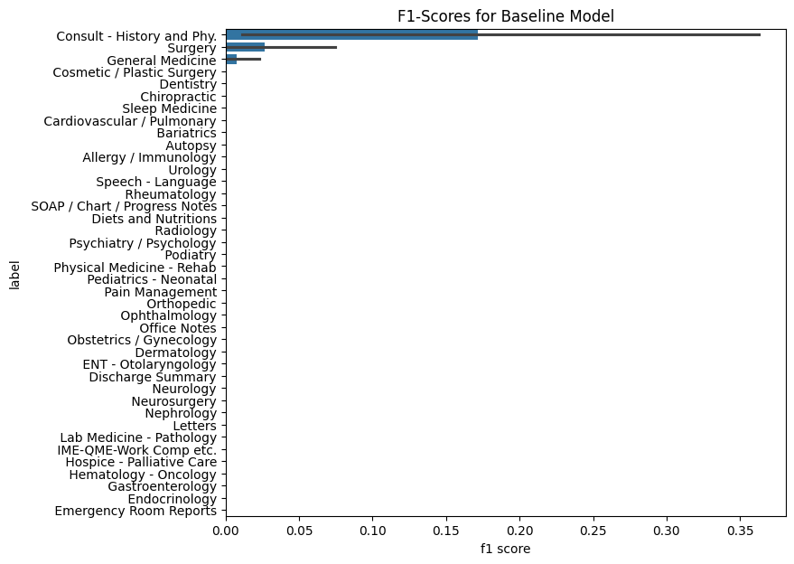
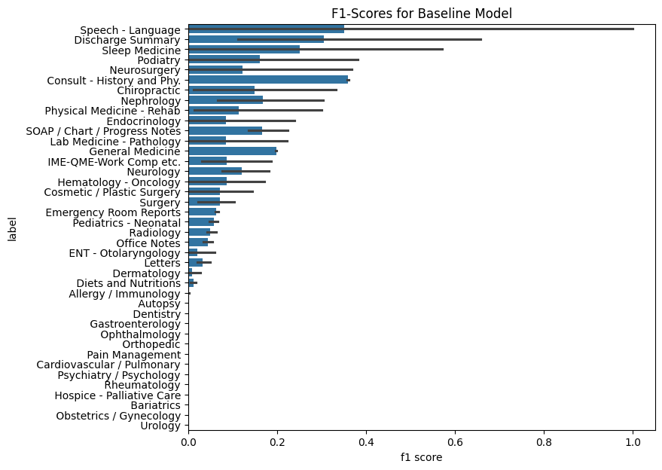
F1-Scores for Baseline Model – Random Forest
RF- unbalanced class weights
RF - balanced class weights

Slide 10
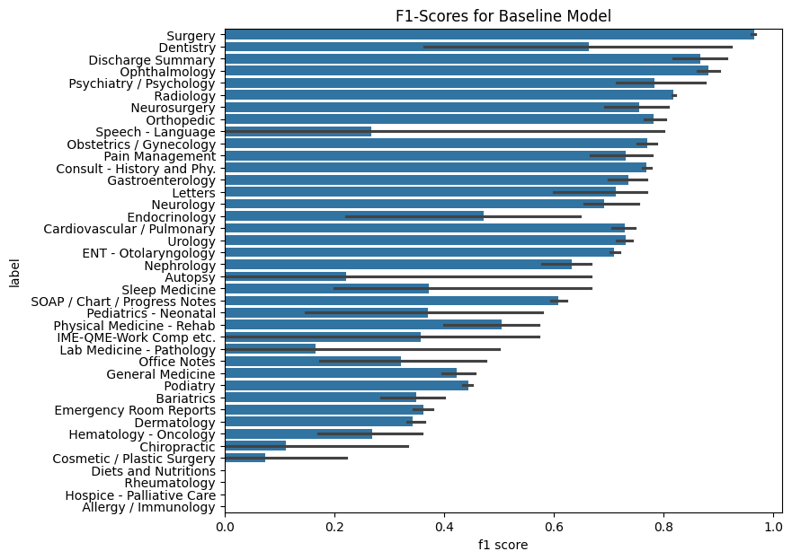
F1-Scores for Baseline Model – XGBoost
XGBoost - unbalanced class

Slide 11
Advanced Models (Task 3)
BERT and GPT
Advanced Models: Exploring the capabilities of BERT and GPT in medical text analysis used for identifying complex language patterns
No preporcessing for BERT
BERT Variants: Utilizing bert-base-uncased and biobert for nuanced text understanding.
GPT Models: Implementing llama2 and meditron for comprehensive label prediction.
Experiment with MEDITRON

Slide 12
Evaluation Metrics
Primary Metric: F1-scores, balancing precision and recall for a holistic performance view
Importance: F1-score is crucial for datasets with imbalanced classes, common in medical texts.

